Slide 1
Google Sheets-The Basics

Slide 2
Basic Orientation
Parts of the sheet:
Title
Toolbar Menu
Saved Changes Notification
Collaboration Options
Shortcuts Toolbar
Formula Bar
Sheets Toolbar

Slide 3
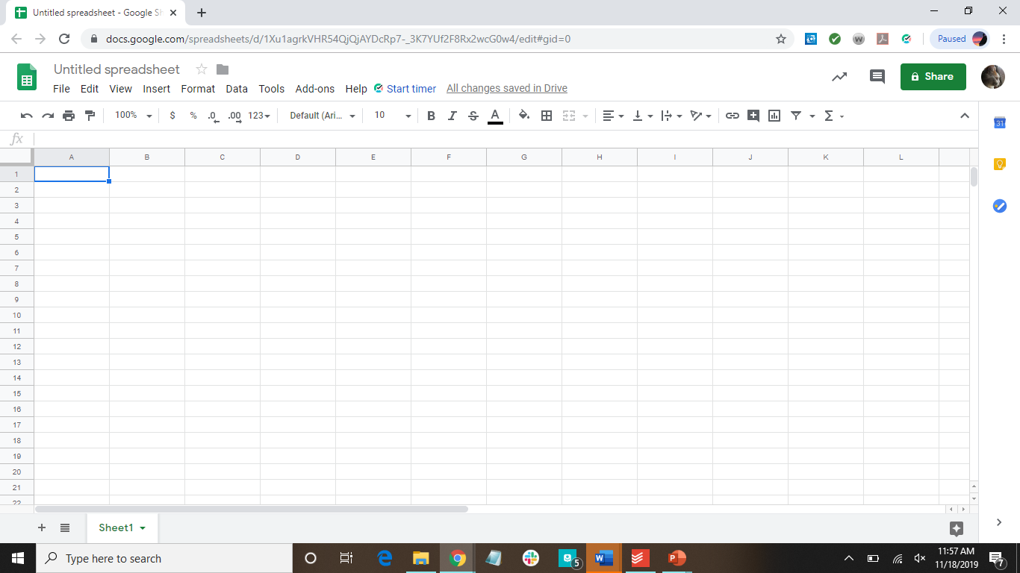

Title
Toolbar menu
Saved Changes Notification
Collaboration Tools
Formula Bar
Shortcuts
Toolbar
Sheets Toolbar

Slide 4
Columns and rows
Both are infinite in number
Each cell has a name
Named by column and row
Range-group of cells next to each other that are grouped together
Name a range by saying the upper left cell through the lower right cell
When writing, through = ‘:’
Sheets add up to form a workbook

Slide 5
Cell A1
Column
Row
Range of cells- H4:I8

Slide 6
How to Navigate Through the Sheet
Enter = move down one
Shift+enter = move up one
**press twice-only once brings you into the cell**
Tab = move right one
Shift+tab = move left one
Can also use the arrow keys
Clicking on the number of a row will select the whole row
Clicking on the letter of a column will select the whole column

Slide 7
Oops! I misspelled a word...
There’s a difference between being on the cell and in the cell
You can edit the words of the cell only when you’re in the cell
Typing will replace what’s in the cell when you’re on the cell
Double click on a cell or press enter to enter into the cell

Slide 8
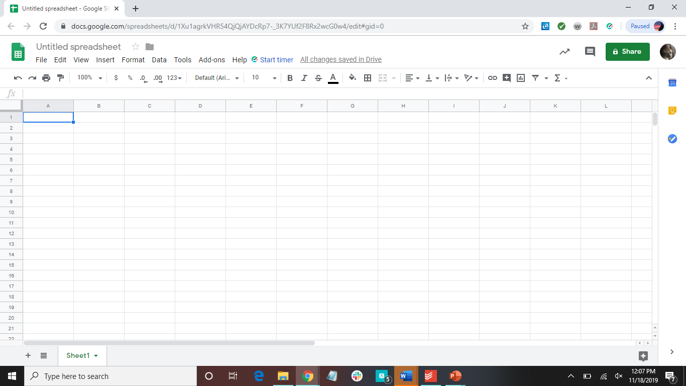
Here you are on the cell

Slide 9

Here you are in the cell

Slide 10
Some Helpful Shortcuts
ctrl+I | italicize
ctrl+B | bold
ctrl+U | underline
ctrl+C | copy
ctrl+X | cut
ctrl+Z | undo
ctrl+V | paste
ctrl+F | find

Slide 11
Let’s get started making a spreadsheet!

Slide 12
Click on A1
Type in “Book Inventory”
Hit enter
Fill in the next line with the following categories:
Title
Author
Total Number of Pages

Slide 13
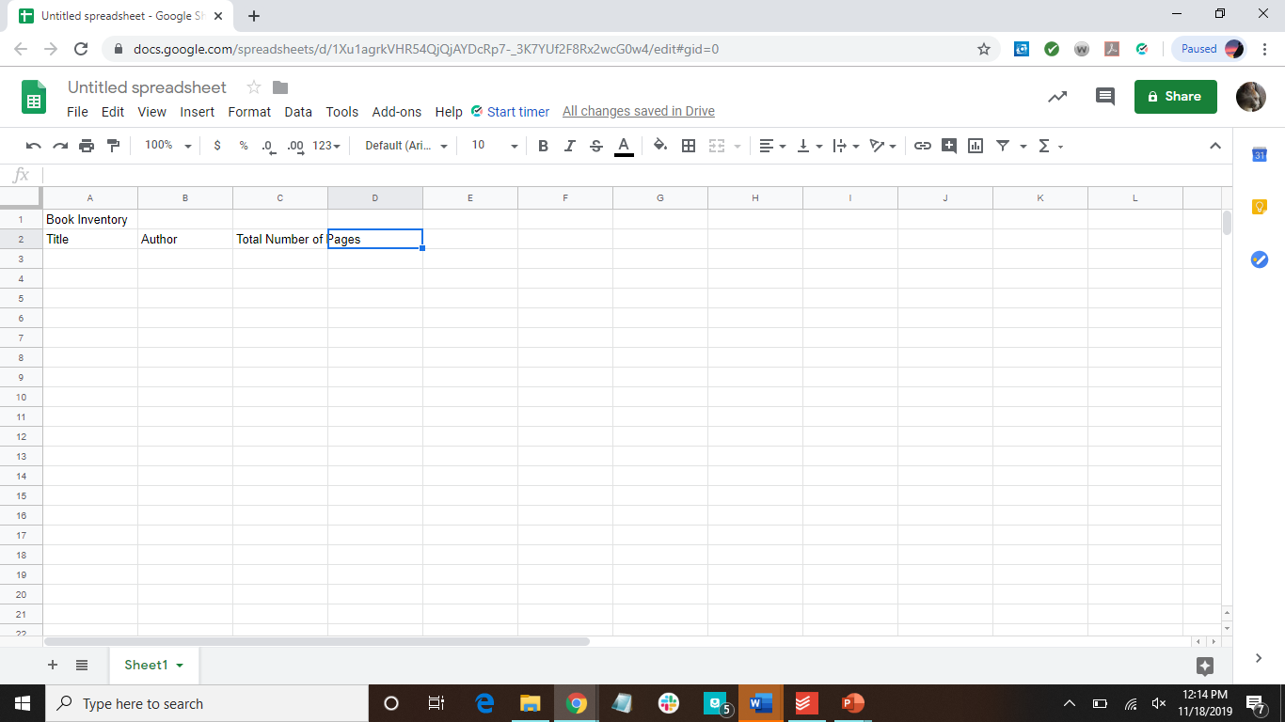

Slide 14
Notice- the words are bigger than the cell appears when you type “Total Number of Pages”
Let’s fix it!
Hover between the two column letters (the column the text is in and the next column) until it turns blue
Click and drag to stretch the column

Slide 15

Hover, then click here and drag

Slide 16
Let’s clean it up and make it look better
Make the top line all one cell
Select the cells in the first row
Click on the Format Tab (up at the top)
Click on Merge cells
Bold, Underline, Italicize as you prefer!

Slide 17
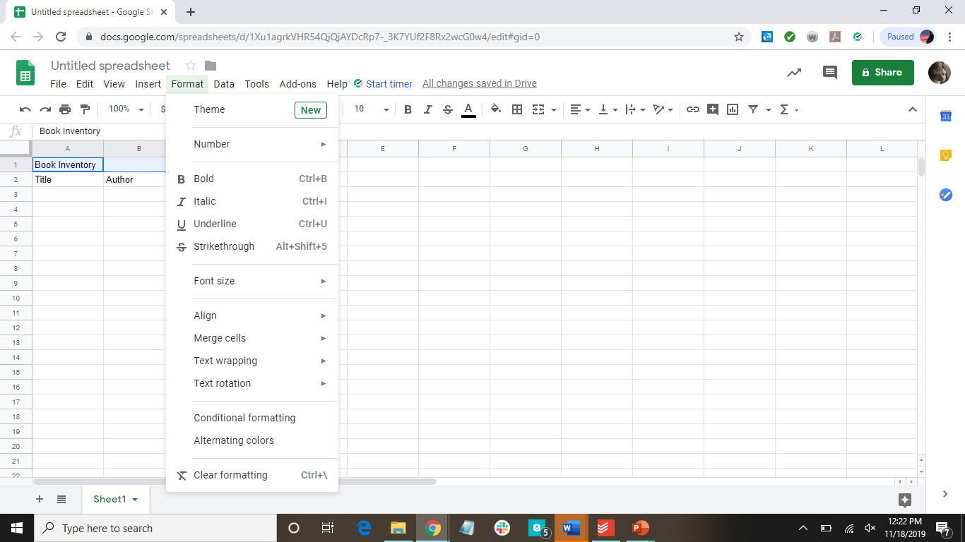
Click here to center the words in the cell
Click here to merge the cells

Slide 18




Here’s Some Data to Add
The Great Gatsby
By F. Scott Fitzgerald
218 pages
Catch-22
By Joseph Heller
453 pages
1984
By George Orwell
328 pages
Midnight’s Children
By Salman Rushdie
446 pages

Slide 19
Analyze Data

Slide 20
How to Add Numbers
Select the cell you want the total to be in
Type =SUM(cell_name:cell_name)
Press enter
***Let’s put the analysis off to the side***

Slide 21
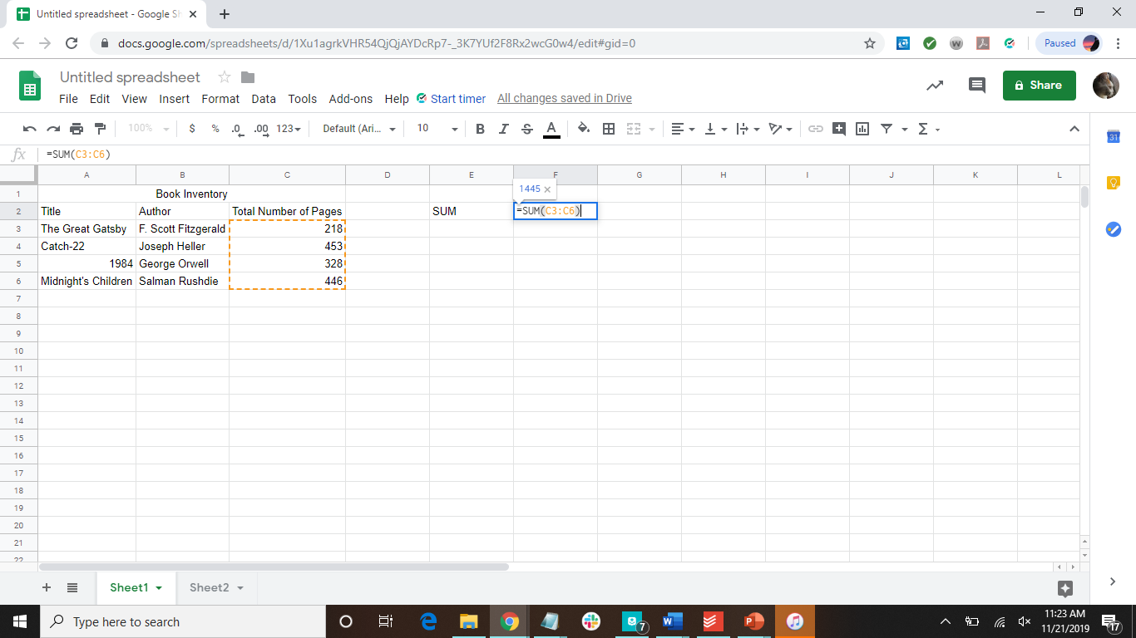

Slide 22


Slide 23
More About the SUM Function
=SUM(D38:D41)
Means “sum the values in cell D38 through cell D41 (cells D 38, D39, D40, D41)”
=SUM(D48,G48:G51,100)
Means “sum the value in D48, the values in cell G48 through G51, and 100”

Slide 24
Add Numbers Over a Certain Number
Select the cell you want the total to be in
Type =SUMIF(cell_name:cell_name, “>50”)
Press enter

Slide 25


Slide 26
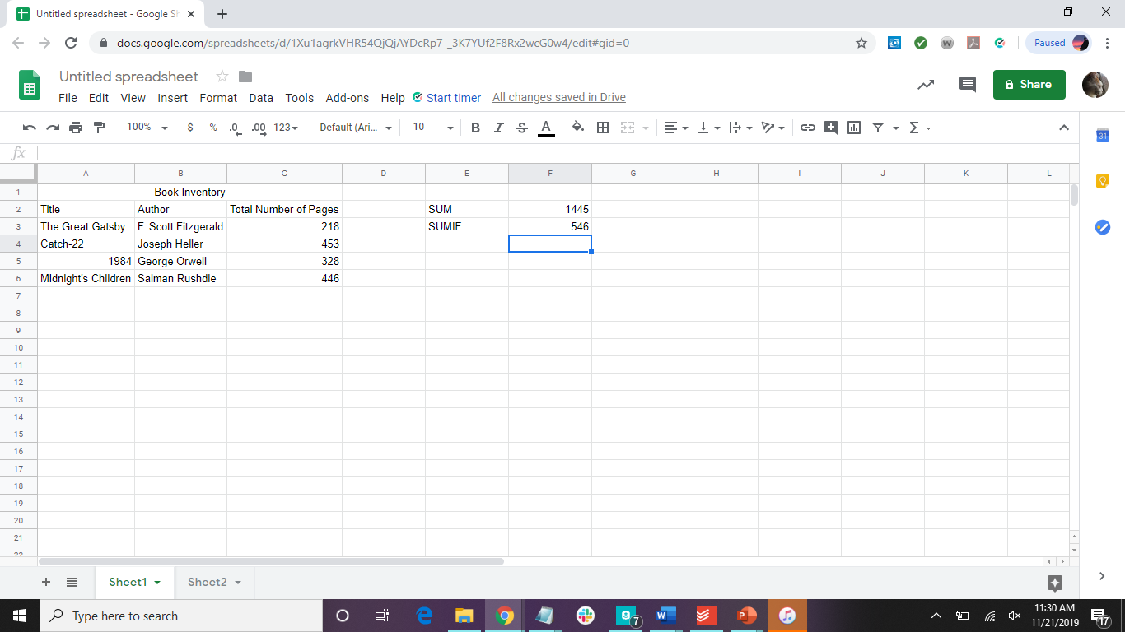

Slide 27
More About the SUMIF Function
=SUMIF(D73:D77, “>50”)
Means “look through cells D73 to D77, and if the value in the cell is greater than 50, sum it”

Slide 28
Math Functions
Adding cells is the cells is the only one with a specific function
Subtract | =cell_name-cell_name
Multiply | =cell_name*cell_name
Divide | =cell_name/cell_name

Slide 29
More Useful Functions
AVERAGE | =AVERAGE(cell_name,cell_name,cell_name,...)
IF | =IF(logical_test, [value_if_true], [value_if_false])
COUNT | =COUNT(cell_name:cell_name)
MAX | =MAX(cell_name:cell_name)
MIN | =MIN(cell_name:cell_name)

Slide 30
AVERAGE Function
Used to find the average of a range of cells
Select the cell you want the total to be in
Type =AVERAGE(cell_name,cell_name,cell_name,...) or =AVERAGE(cell_name:cell_name)
Press enter

Slide 31
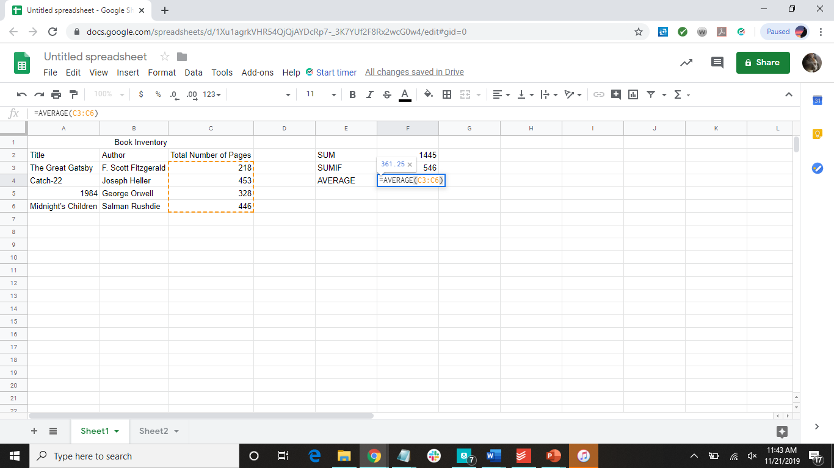

Slide 32
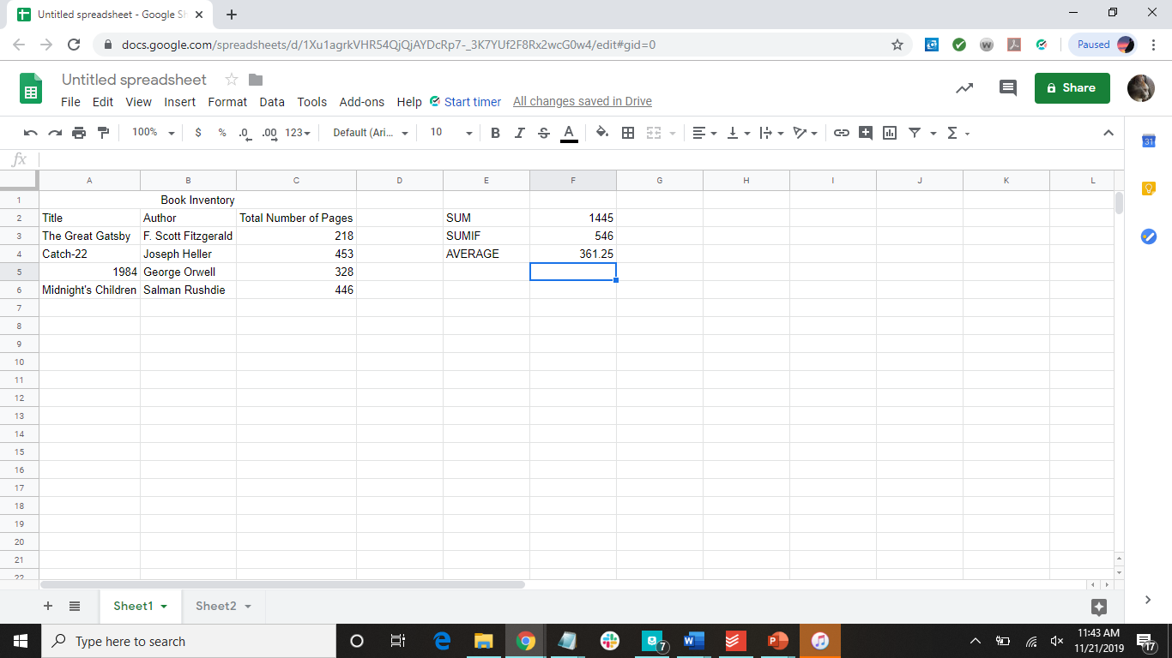

Slide 33
IF Function
Used to test relationships between two cells or to check if a cell has a certain number in it
Select the cell you want the total to be in
Type =IF(logical_test, [value_if_true], [values_if_false])
Press enter
Example: =IF(C3<C4, “TRUE”, “FALSE”)

Slide 34


Slide 35


Slide 36
COUNT Function
Used to count how many data points are in a range of cells
Only works for numerical data points
Select the cell you want the total to be in
Type =COUNT(cell_name:cell_name)
Press enter

Slide 37
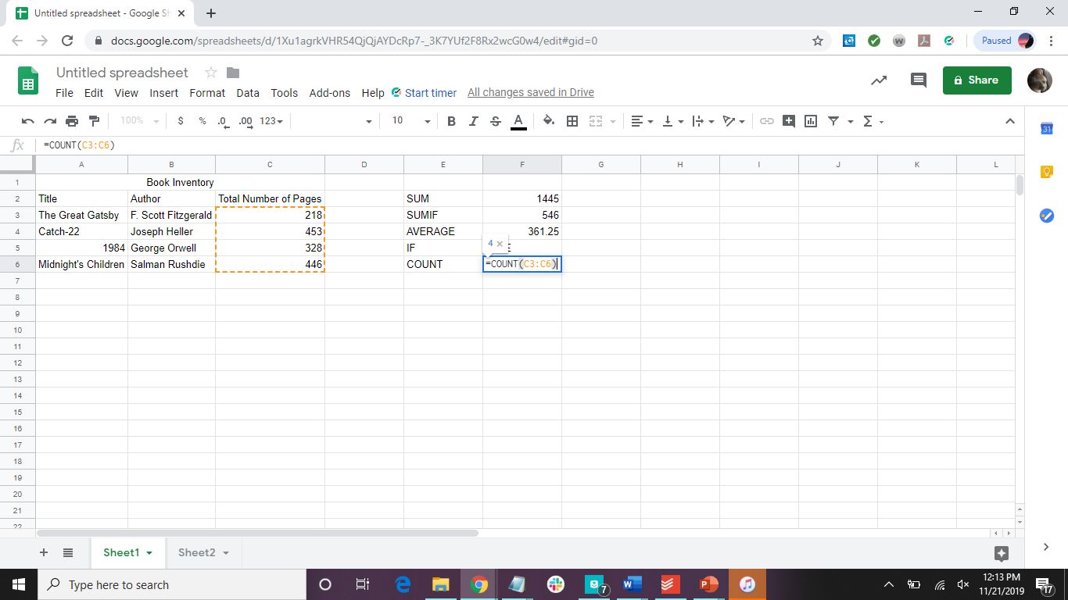

Slide 38
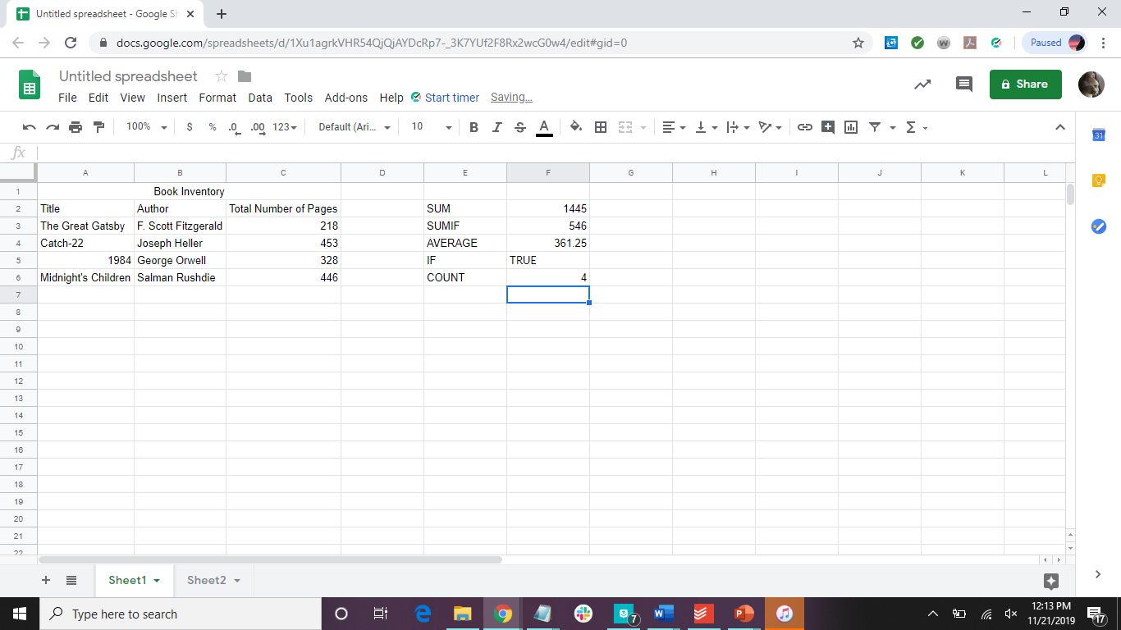

Slide 39
MAX Function
Used to find the largest number in a range of cells
Select the cell you want the total to be in
Type =MAX(cell_name:cell_name)
Press enter

Slide 40


Slide 41


Slide 42
MIN Function
Used to find the smallest number in a range of cells
Select the cell you want the total to be in
Type =MIN(cell_name:cell_name)
Press enter

Slide 43
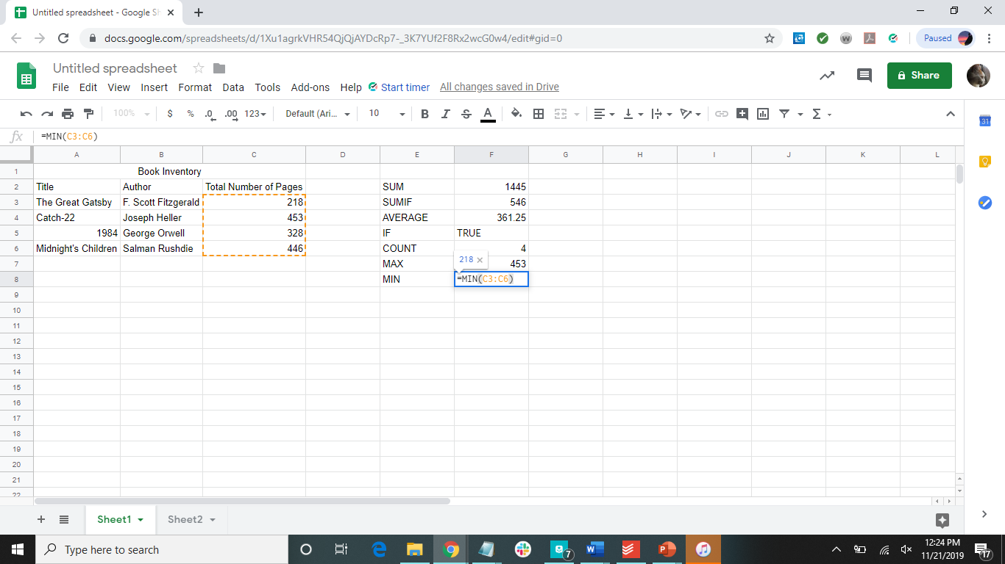

Slide 44
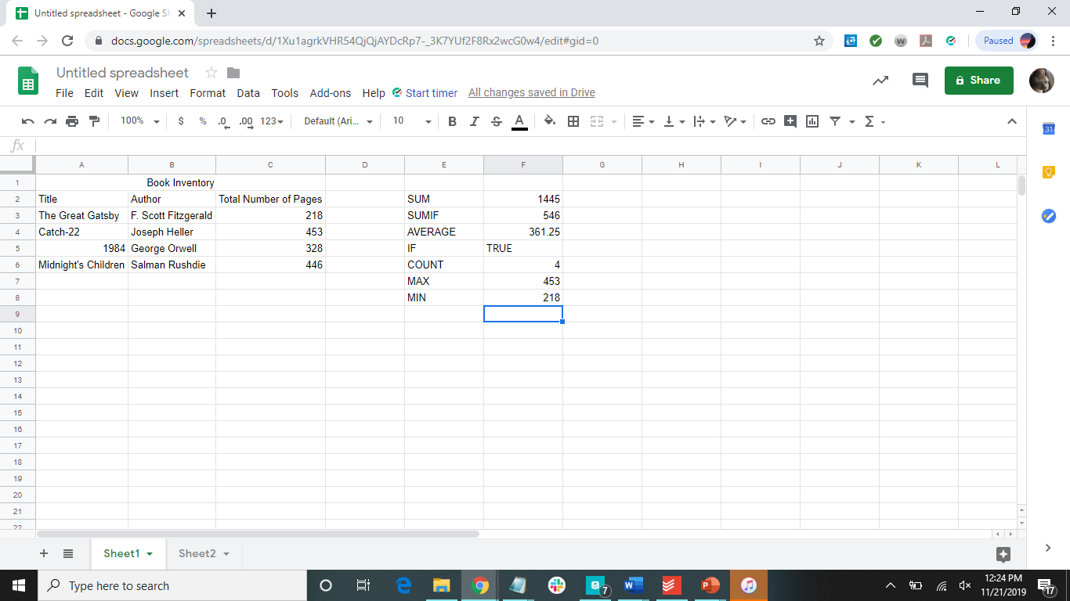

Slide 45
How to Calculate Standard Deviation
Select the cell you want the standard deviation in
Look at the data and decide which to use:
There are other versions that you can find to fit the data you have
If your data has cells with text that needs to be ignored:
Type =STDEVPA(cell_name:cell_name
If your data has cells with only numbers:
Type =STDEV(cell_name:cell_name

Slide 46
How to Calculate Standard Error
There is no built in function to calculate for this, but you can build the formula like as follows:
=STDEV.S(cell_name:cell_name)/SQRT(COUNT(cell_name:cell_name))

Slide 47
Fill in Cells Automatically
Fill down:
Rest cursor on the lower-right corner of the cell until it becomes a cross
Click the cross and drag down the cells you want it to fill
Fill right:
Rest cursor on the lower-right corner of the cell until it becomes a cross
Click the cross and drag down the cells you want it to fill

Slide 48



Here’s Some More Data
A Dark Inheritance
By Chris d’Lacy
304 pages
Alexander’s Army
By Chris d’Lacy
304 pages
A Crown of Dragons
By Chris d’Lacy
352 pages

Slide 49
Notice:
All three have the same author
Let’s use automatic filling to input the author for these books

Slide 50
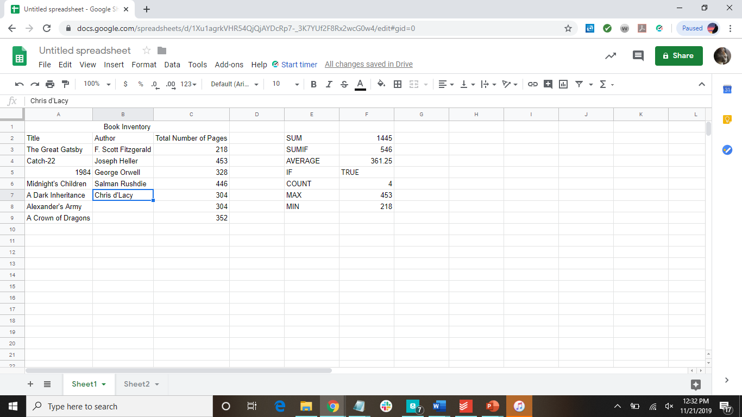
Hover, then click and drag down

Slide 51
What can filling cells automatically be used for?
This can be used for many things:
Filling in patterns
Numbers, or letters
Excel will automatically detect specific patterns, such as:
Months
Dates
Number patterns
For a number pattern, see next slide
Filling in cells with the same word

Slide 52
Fill Cells Automatically with a Pattern
Fill at least two cells in the pattern
Select full pattern
Rest cursor on the lower-right corner of the cell until it become a cross
Click the cross and drag across the cells you want it to fill

Slide 53
To practice with automatically filling a pattern, let’s number the books in our inventory
In order to do this, we need to add a column in the front

Slide 54
How to Add a Column
Click on the column letter to select the whole column
Right-click, and select insert

Slide 55
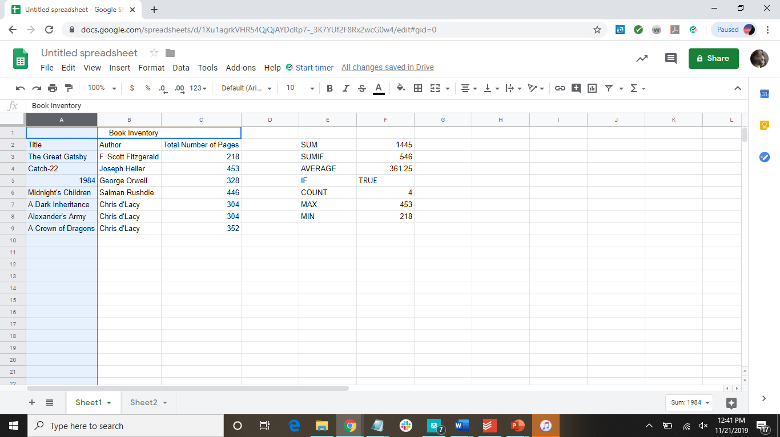

Slide 56
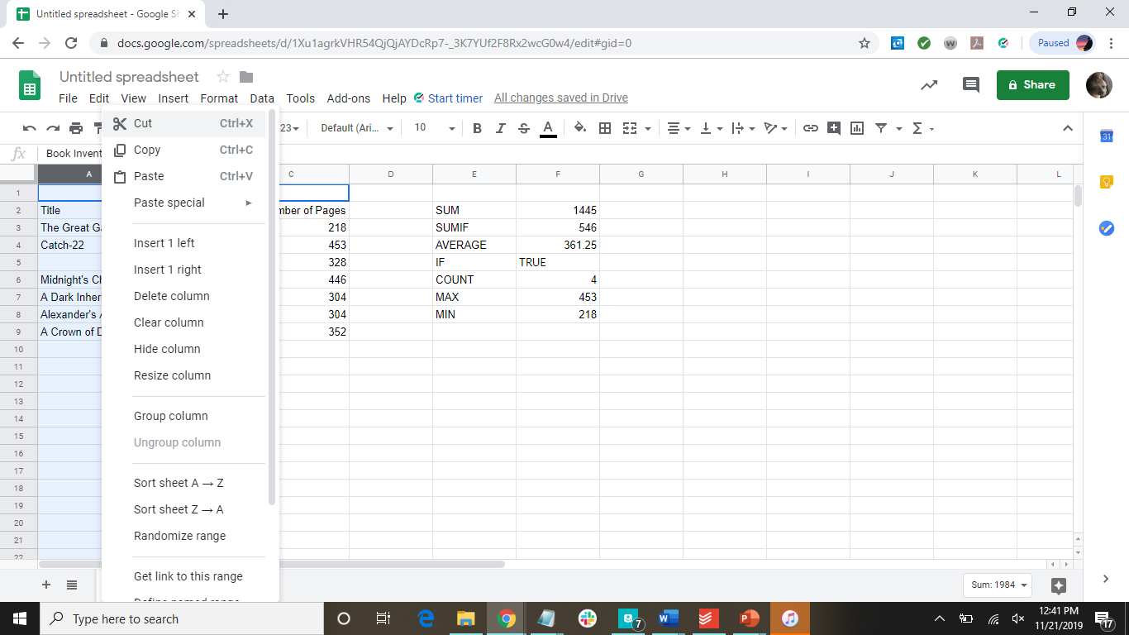

Slide 57
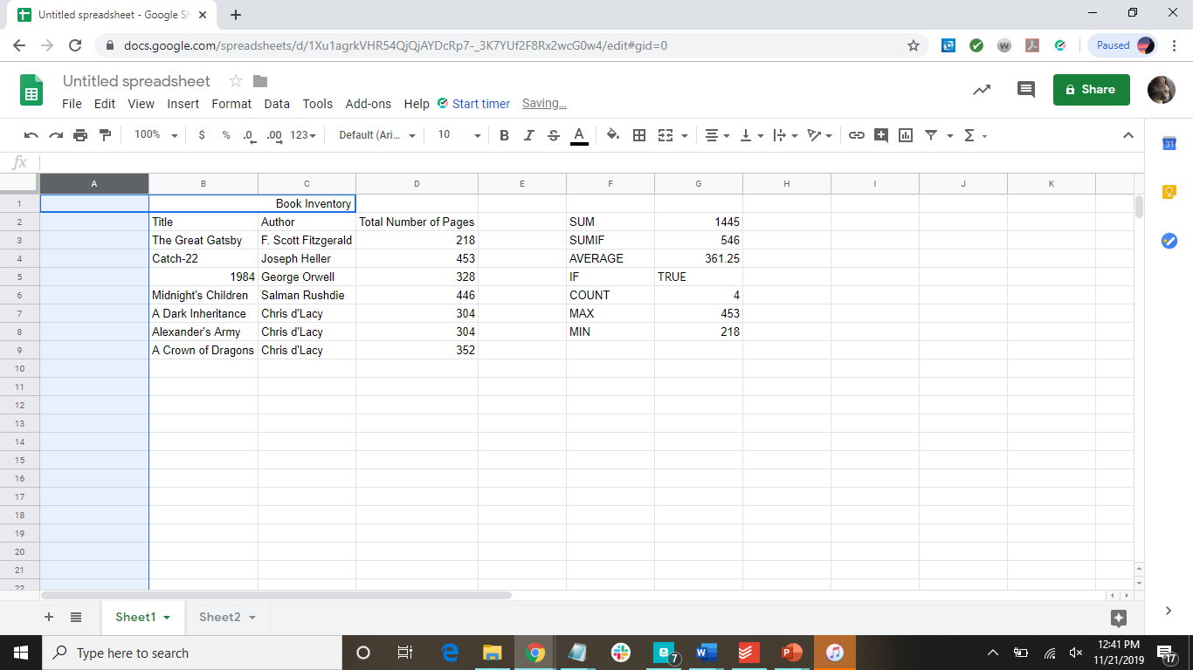

Slide 58
Now we can number them:
All that is needed is numbering the first two, and sheets can fill in the rest!

Slide 59
Fill Cells Automatically with a Pattern
Fill at least two cells in the pattern
Select full pattern
Rest cursor on the lower-right corner of the cell until it becomes a cross
Click the cross and drag down the cells you want it to fill

Slide 60
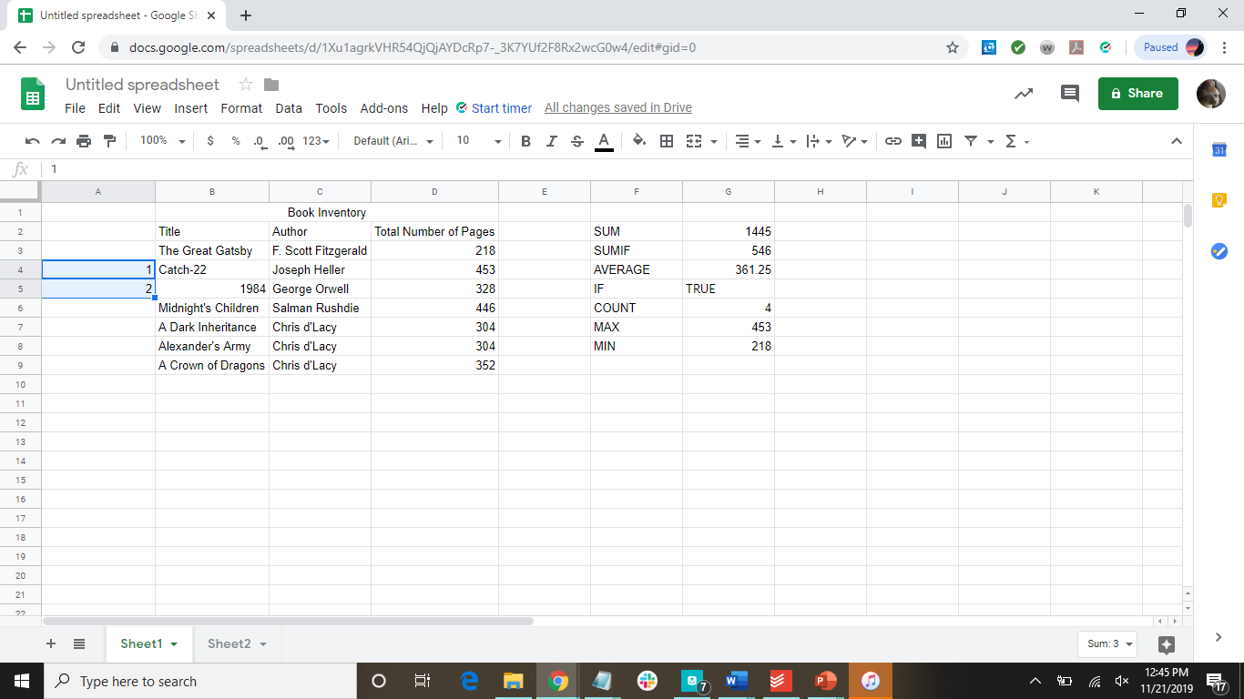
Hover, then click and drag down

Slide 61
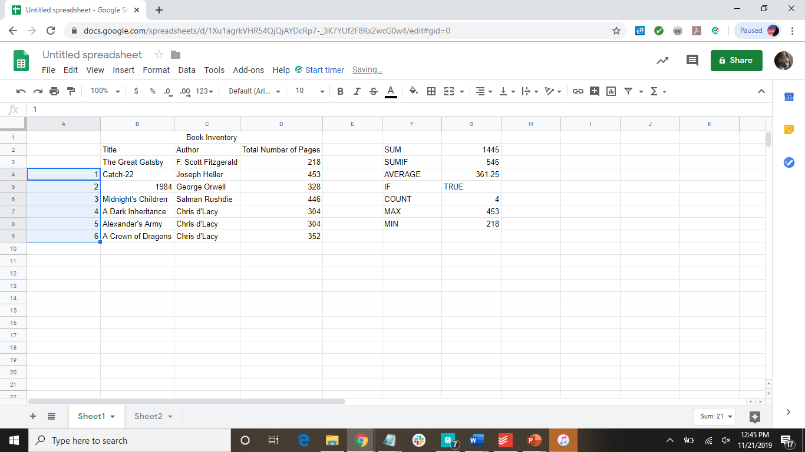

Slide 62
Represent Data

Slide 63
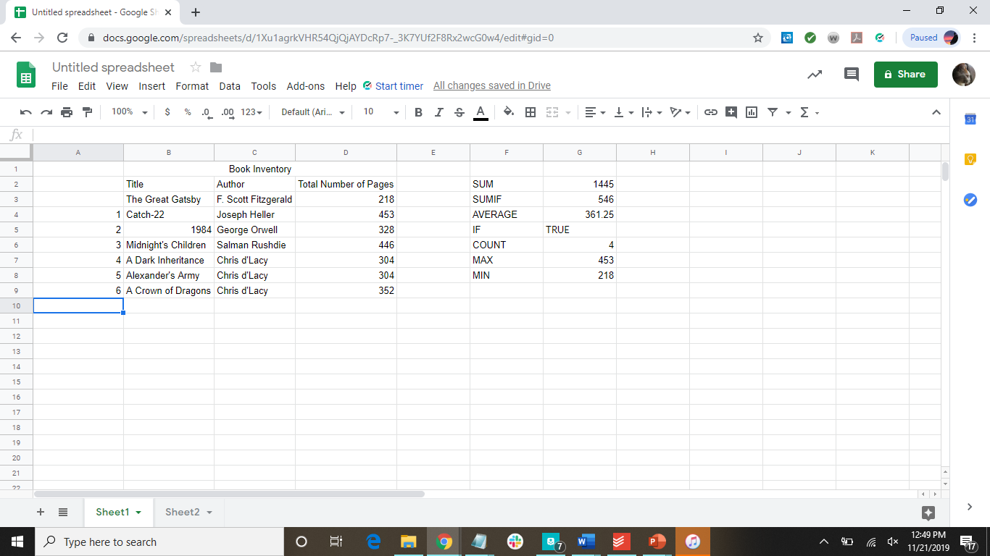
Let’s create a new sheet for some data
Click here for a new sheet

Slide 64
Let’s add some data
Headers: Variable 1 and Variable 2
Data: the following coordinates:
(1,1), (2,2), (3,3)... (10,10)
***you can fill the cells automatically, as we learned earlier***

Slide 65


Slide 66
How to Make Charts
Select the cells containing the data you want a chart made from
Click on Insert
Click on Chart

Slide 67
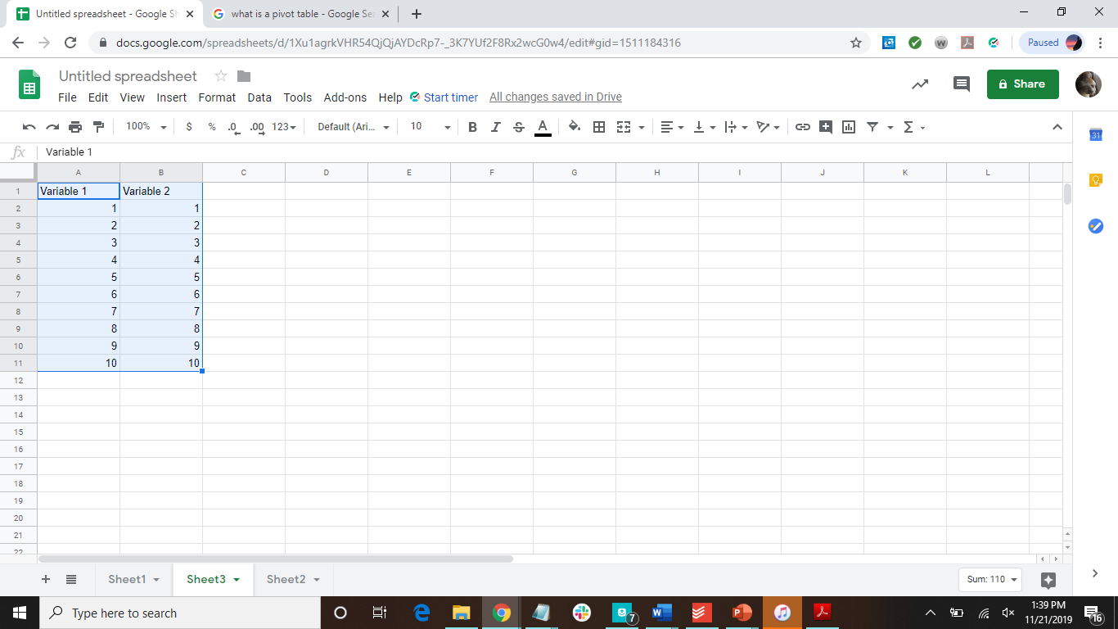

Slide 68
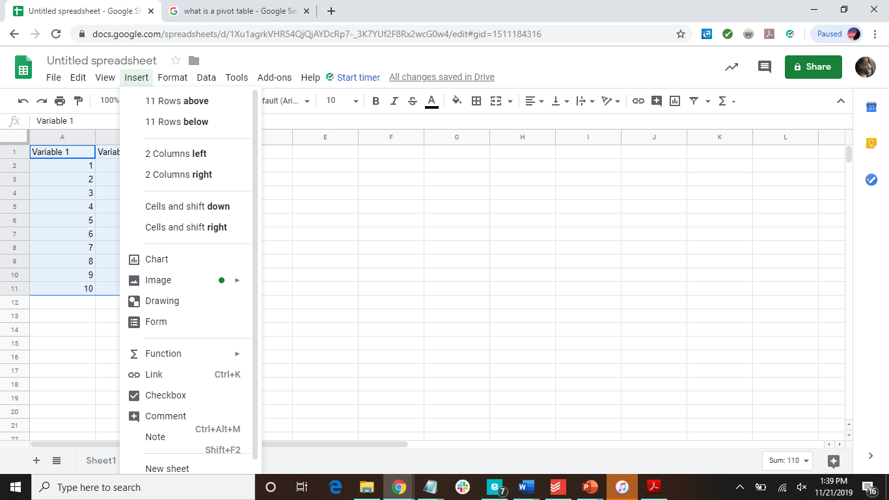

Slide 69

Change the design of your chart here

Slide 70
Shortcuts
ctrl+I | italicize
ctrl+B | bold
ctrl+U | underline
ctrl+C | copy
ctrl+X | cut
ctrl+Z | undo
ctrl+V | paste
ctrl+F | find

Slide 71
Functions
SUM | =SUM(cell_name:cell_name)
SUMIF | =SUMIF(cell_name:cell_name, “>50”)
AVERAGE | =AVERAGE(cell_name,cell_name,cell_name,...)
IF | =IF(logical_test, [value_if_true], [value_if_false])
COUNT | =COUNT(cell_name:cell_name)
MAX | =MAX(cell_name:cell_name)
MIN | =MIN(cell_name:cell_name)

Slide 72
Have more questions?
Assignment
Submit the Google Sheet you created during this presentation.
Email us at ccla@doane.edu or come visit us in Communications 188D from 9am to 5pm.
You can also visit our website at https://www.doane.edu/ccla

Slide 73
References
GCFLearnFree.org. Google Drive and Docs (Google Sheets). Retrieved from https://edu.gcfglobal.org/en/googlespreadsheets/

Slide 74

Please provide some feedback on the presentation by following the QR Code below.

